Slide 1
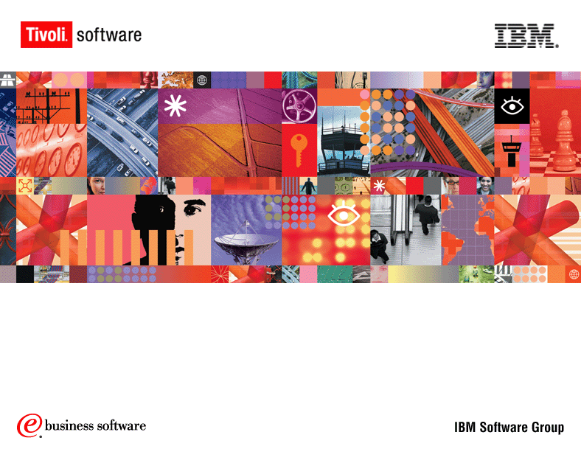
Tivoli Identity Manager 4.3.1
An Introduction
Stefan Köhler
Tivoli Security
Notes:
Hello, my name is Bob Madey. Today, I will talk with you about one of the most critical challenges faced by every IT organization – Integrated Management.
As part of Tivoli’s senior product team --it’s my job to provide our customers with the best possible products and solutions to integrated management. Products and solutions that allow you to address the various issues that arise from the heterogeneous IT environments we all face today. It is also my responsibility to work with our fellow IBM software brands – WebSphere, Lotus and DB2 Data Management software – to meet your integration concerns on all levels.
I’d like to start our discussion today with an overview of the IBM integration strategy….and how Tivoli is an integral part of this strategy.

Slide 2
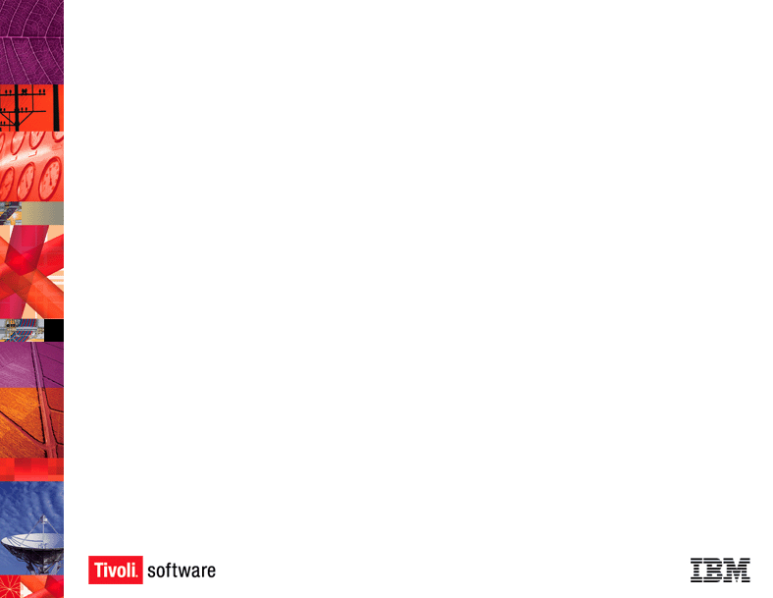
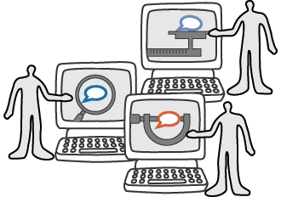



Policy-Based Provisioning Controls User Privileges
We provision people with resources!
We also de-provision them and ensure that “only those you want to have access actually do”

Slide 3











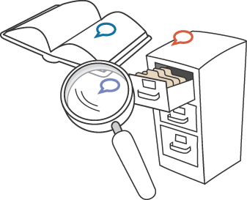



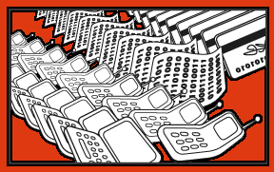
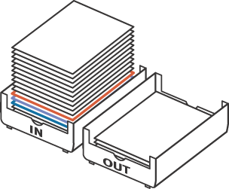

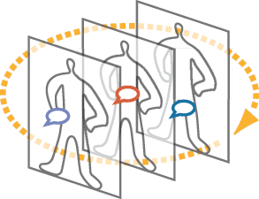

Manual Provisioning
Why Today’s Methods Don’t Work
Today most organizations use manual processes to provision user access rights
BACKLOGS
Request for
Access
Generated
“30-60% of the access profiles in companies are no longer valid”
- Chris Christiansen, IDC
New Users
MISSING
AUDIT TRAIL
Provisioned Users
REQUESTS
DELAYED
Administrators
GROWING
RESOURCES
Policy &
Role Examined
Manual provisioning can take up to 12 days per user
ERRORS
IT InBox
Approval
Routing
INCOMPLETE
REQUEST FORMS

Slide 4
ROI
Hard Dollar ROI
  Reconcile lost cost in resource over-provisioning
  - 60 % in most orgs
  Reduce costs associated with provisioning
  - $200 savings per user
  Reduce management overhead
  – 40% of help desk calls are password related
Soft Dollar ROI (efficiency)
  Reduce time to provide user access – days to minutes
  Reduce time to de-provision resources – automatic
  Reduce threat of security breach – policy managed access

Slide 5
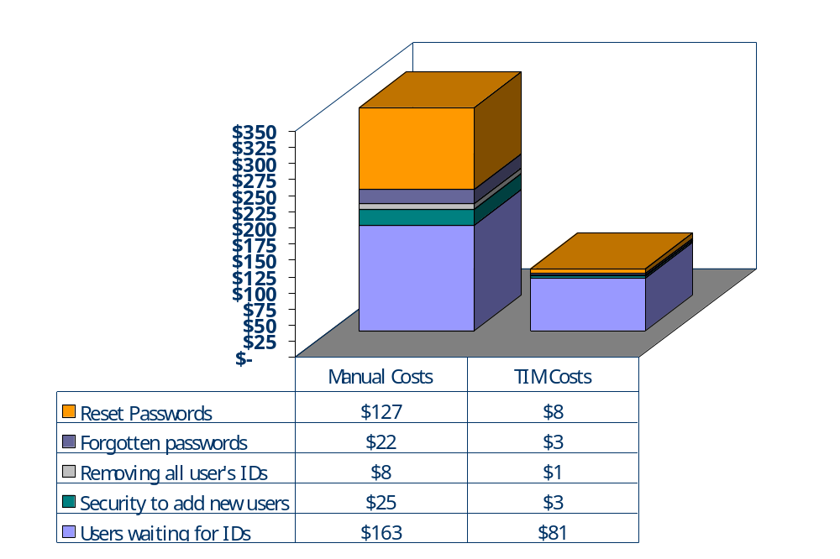
Savings from Automation
Cost metrics
  25,000 users
  25% yearly growth
  38% annual turnover
  40% application access changes (job changes, turnover, etc.)
  30 day password refresh
  Average 6 IDs/user
  2 day SLA
  15 person Security staff
  14 person Helpdesk staff
$346
$96

Slide 6
TIM Functionality
Automatic Population Feeds
from HR Databases or Directory Services
Workflow-Based Approval
and Sponsorship Environment
Delegation of Administrative Privileges
in Distributed Organizations
Web-Based Access
for End-Users and Administrators
Self-Service for Users
to set and sync Passwords and create/modify accounts
Complete Audit & Reporting
to ensure activity tracking

Slide 7
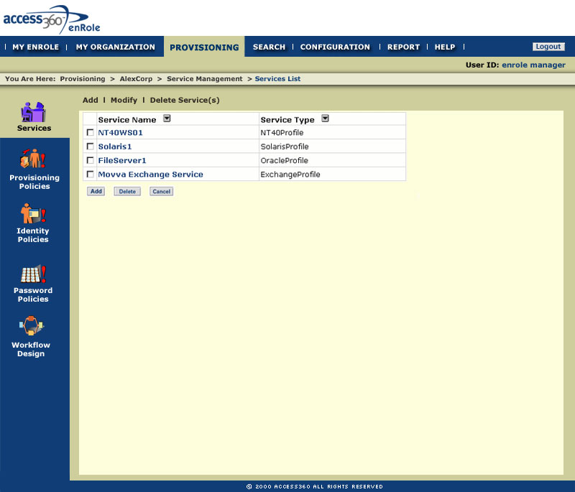
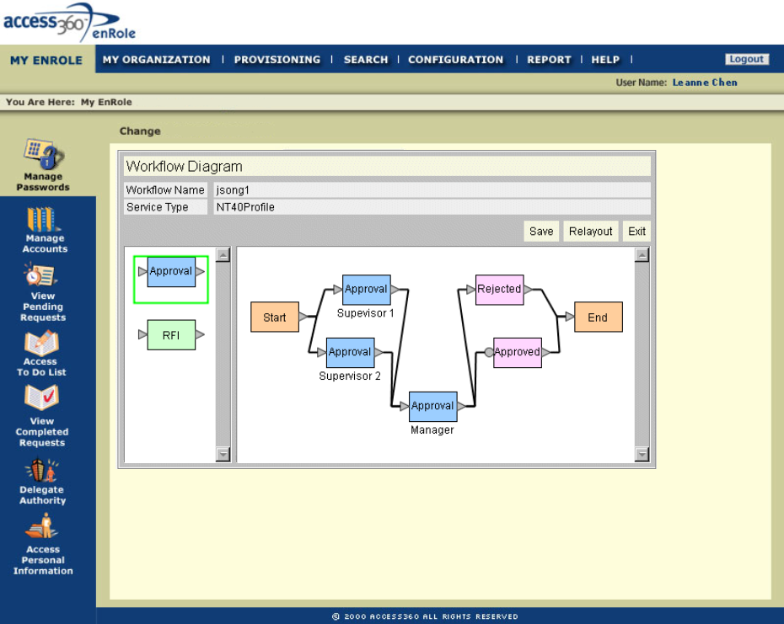
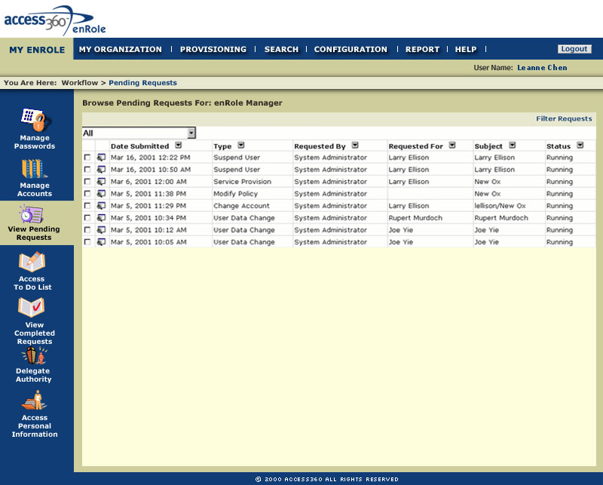
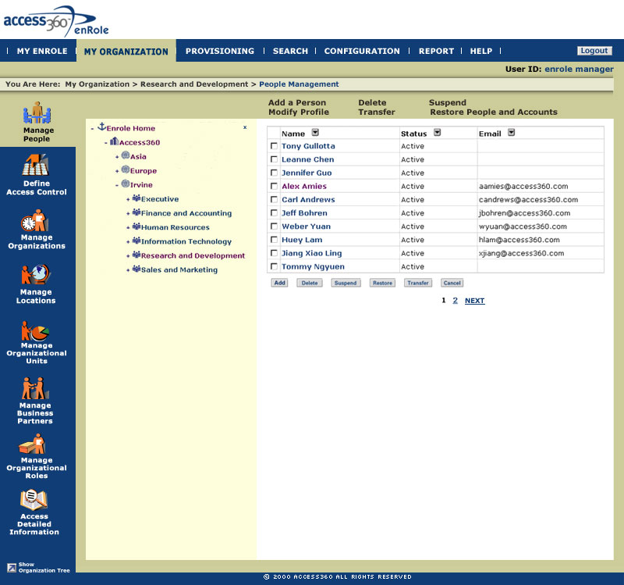
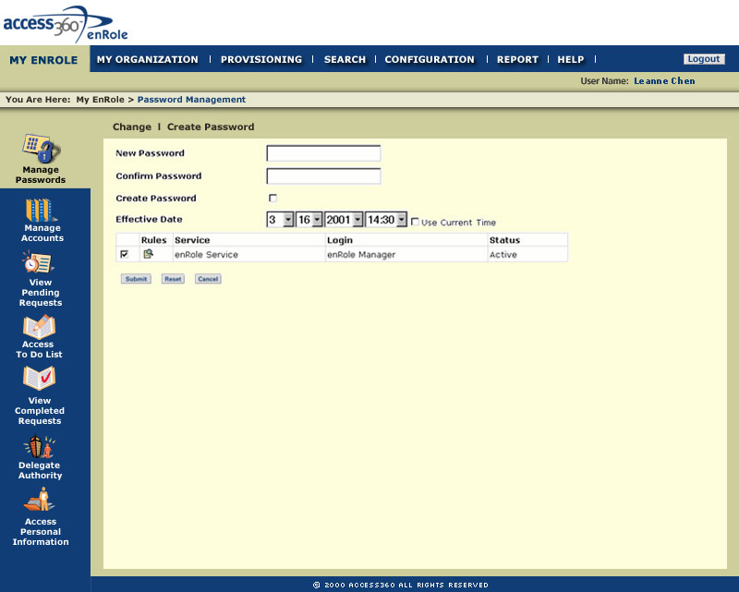
Step by Step Provisioning
Request access to resource
Approval routing
Request is approved
Provisioning complete
Password self-service enabled

Slide 8



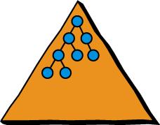



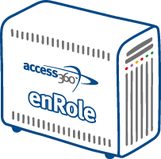

TIM Operational Context
End User
Interface
Access
Request
Notifications
Web
Administrator
Interface
HTML/
HTTPS
TIM
Application
Servers
Grant Access
Change Access
Delete Access
Suspend Access
Restore Access
Change Detected
Reconcile
Change
Event
Change
Event
XML
XML/
HTTPS
Bulk
Load
Bulk
Load
LDAP
JDBC
Agents
Central Identity Store(s)
(Corporate Directories,
HR Systems)
Audit & History
Tracking

Slide 9








Persons and Target Systems
Provisioning
Policies
Target
Systems
Roles
Persons
Entitlements

Slide 10
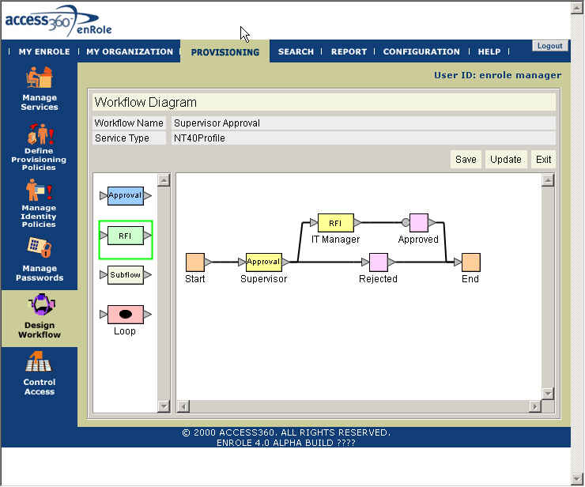
Policy Management Engine
Dynamic Determination of Access Rights
  Change in users
  Change in information about a user
  Change in policy
Policy has 3 parts:
  A group of users
  Access rights to be granted
  A process to approve it
Graphical Workflow Designer
  Custom workflow processes
  Drag and drop support
  Serial and parallel approvals
  Data collection support
  Re-usable workflow designs

Slide 11
Reconciliation
A closed loop to synchronize user privilege information
  Local administrators make changes
  Near real-time or batch change updates
Maintain consistency of data between local info and master source
Evaluate Change Against Policies
Accept
Suspend Acct
Rollback Acct
Change/Suspend
4
3
Databases
1
Databases
Databases
2
Databases
!
Local Admin
Entitlement/User Change Detected!

Slide 12


Connectors for your environment are key
Because…
Connector becomes a virtual administrator
Each resource uses different parameters and APIs
Agents must be transparent and secure
Windows 2000
88 Different Parameters
Sample Parameters…
AccountExpirationDate
AllowDialin
AllowEncryptedPassword
BadLoginCount
CannotBeDelegated
Company
Container
LastLogoff
SAP
182 Different Parameters
Sample Parameters…
LoginId
VariableAction
ACCOUNT
BUILDING
CATT CATT
GROUP
DATEFORMAT
LDAP Applications
Unlimited Parameters
Sample Parameters…
ctxt_create_user_and_properties Add
ctxt_set_rel Add
ctxt_delete_obj Delete
ctxt_get_obj_by_name Modify
ctxt_save_user_and_properties Modify

Slide 13

TIM Agents to Access Control Systems
Authentication
& Security
Custom &
Packaged
Applications
Application, Web
& Messaging
Servers
Data, Content
& Identity
Repositories
Universal
Family
Platform
(Hardware/OS)
Netegrity*
Oblix*
Securant Cleartrust
Entrust getAccess
Tivoli Policy Dir.
VeriSign*
Cisco ACS*
Baltimore PKI
Entrust PKI
MVS RACF
MVS ACF2
MVS Top Secret
TPX Session Mgr
RSA BoKs
RSA SecureID
Tandem Safeguard & Guardian
PeopleSoft*
SAP*
JD Edwards*
Oracle ERP*
Siebel*
Clarify
Notes*
Exchange*
Exchange2000*
Groupwise*
DB2/UDB
Oracle RDBMS*
Sybase*
SQL Server*
SQL Server 2000*
Informix
UPA*
LDAP-X*
  AD
  iPlanet
  OID
  Tivoli
  NDS
RDBMS-X*
CLI-X
AIX (NIS)
AS/400
HP-UX (NIS)
Linux
Novell*
Solaris (NIS)
VMS
Win2000*
Win NT (PDC)*
Design Characteristics
  Secure
  Bi-Directional
  Firewall Friendly
  *Optionally Operates Remotely

Slide 14

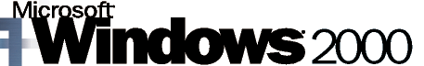




Universal Agents
Access Request Approvers
TIM
Off-The-Shelf Agents
Supervisor/ Business Partner
HR Systems/ Identity Stores
Agents for Custom and Unique Requirements
LDAP-X
CLI-X
RDBMS-X
UPA

Slide 15





System Architecture
Application Server Cluster
Load-Balanced Web Servers
RDBMS (Mirrored)
LDAP Directory
Scaling
Scaling
Scaling
DMZ
Trusted
Data Vault
Firewalls

Slide 16
TIM Features and Functions
Scalable, High Availability Architecture
  Support 10’s of millions of users
  Easily configure for robust operation
  Secure execution across public Internet
Role based Architecture
  People can belong to one or more organizational roles
  Static and dynamic roles
  Change in roles will immediately be reflected on resources
Policy Management Engine
  Manage larger numbers of users with less effort
  Support role based access management
  Dynamic reactions to changes in users or policies
  Policy Joins
Workflow Environment
  Support approval and data collection processes
  Drag and drop designer
  Re-use of designs across systems
  Dynamically determine approval authorities

Slide 17
TIM Features and Functions
User Interface
  Easier to learn and use based on human factors analysis
  Features to manage larger numbers of users and services
  Support for international languages
User self service
  Self-service access requests
  Self-service password management
Delegation of Authority
  Sophisticated User right management
  Admin Domains
Organizational Structure
  The organizational structure of an enterprise is shown in the GUI.
  Objects can exist at any part of the organization

Slide 18
TIM Features and Functions
Flexible Agent Concept
  Connect appr. 70 target systems with standard agents
  Set of universal agent
  Agent developent kit
Agent Communication Mechanisms
  Internet friendly
  Secured to cross the public Net
Agent Reconciliation Capabilities
  Detect when an access privilege change is made in the field
  Manage time and bandwidth required for a recon
Extensive Auditing and Reporting support
  All activities are logged in a database
  Standard reports come with the product
  Customer can write their own report (e.g. based on crystal reports)

Slide 19
TIM Supported Environment
Server: AIX, Solaris, HP-UX, Windows 2000
Directory: IBM Directory Server, iPlanet Directory
Server
Database: DB2, Oracle, SQL Server 2000
Web Server: WebSphere, iPlanet, BEA WebLogic
Application Server:
WebSphere, BEA WebLogic
Browser: Internet Explorer, Netscape

Slide 20
TIM and TAM Integration
Provisioning
TAM
TIM
Single Sign On

Slide 21
TIM JAVA APIs
APIs offer another degree of flexibility
  Authentication
  Access and manipulation of objects
  Logging
  Notification Mails
  Javascript extentions

Slide 22



Thank you for your interest!
Any additional questions?
Notes:
So, there you have it….Tivoli software from IBM is an intelligent choice for your systems management integration requirements. The solutions I have discussed today can bring your business a measurable Return on Investment…through increased productivity of your IT personnel and an improved ability to deliver on service level agreements.
In addition, our integrated solutions are linked to your business needs and enable you to significantly impact the improvement of your business operations – while helping to protect your IT investment.
As I mentioned before, more information about our products and details about Tivoli integration are available by visiting www.ibm.com/tivoli or by contacting your IBM or Tivoli sales representative. In addition, this series offers in-depth discussions about many of our solutions. I encourage you to learn all you can about how the Tivoli of today – can be the only software management partner to meet both your needs for today…and for tomorrow.
Thank you for your attention.

